Slide 1

HOME
ABOUT US
NEXT SLIDE
SURVEIRAMS
INTRODUCING
KAYVI byte.

Slide 2
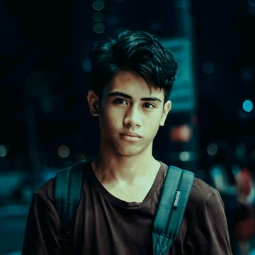
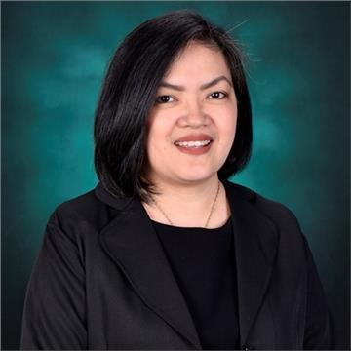
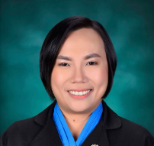
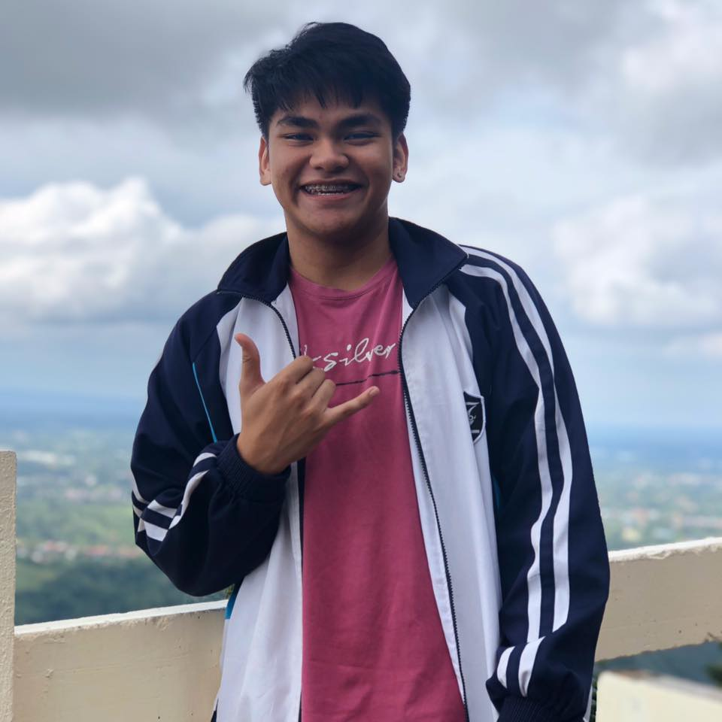
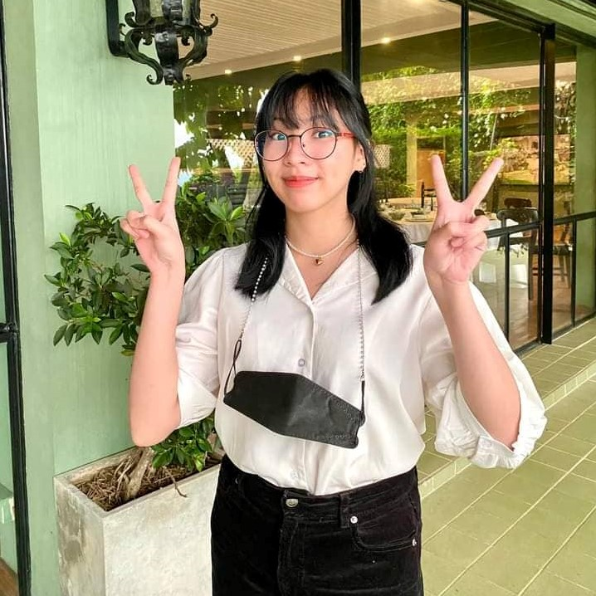
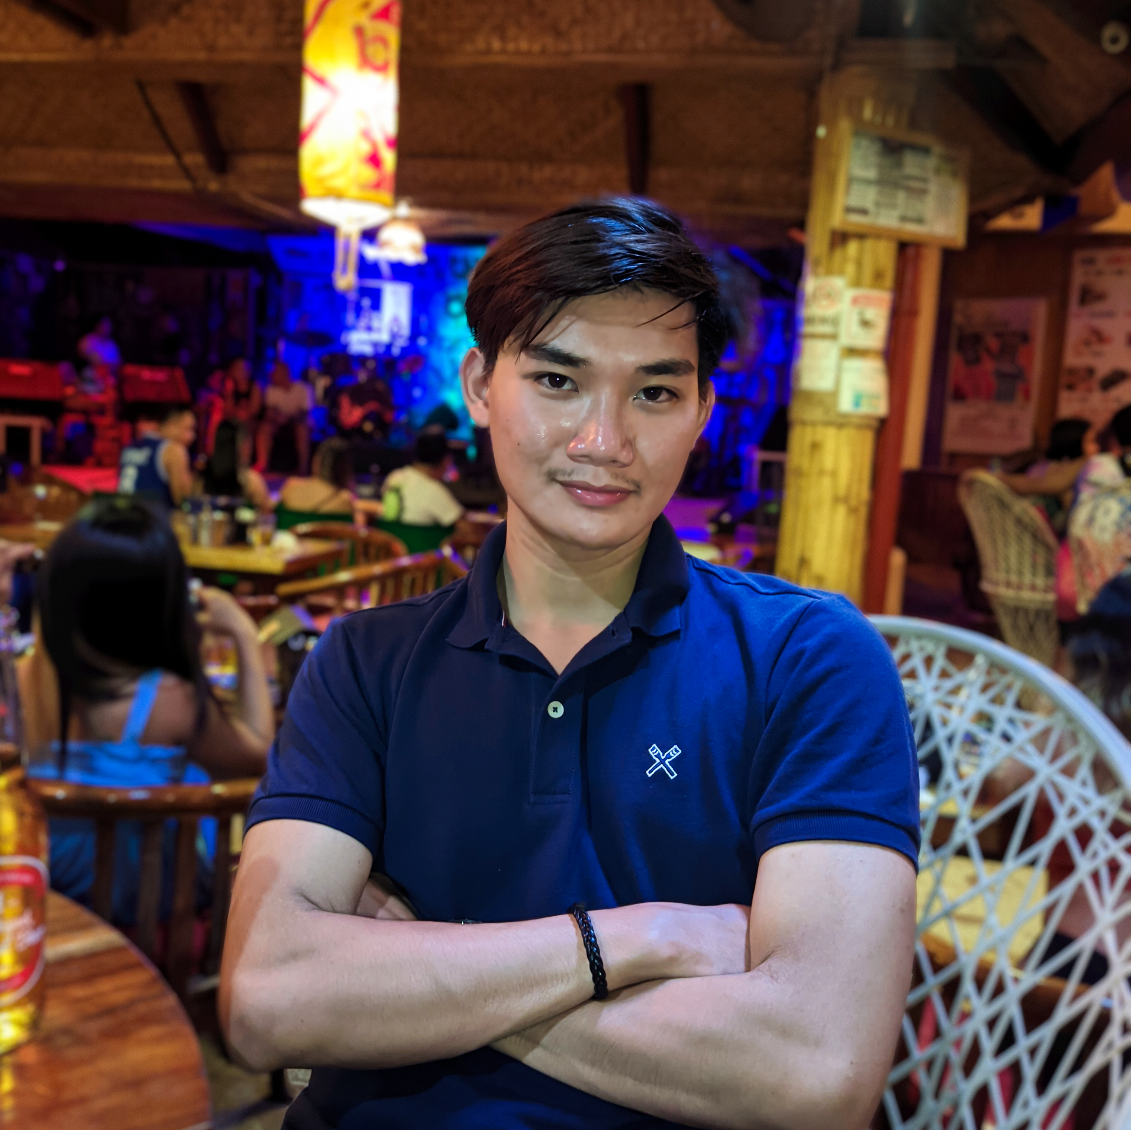
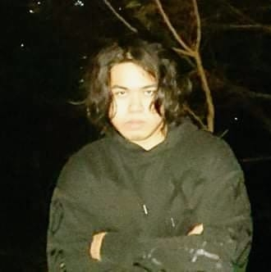
HOME
ABOUT US
NEXT SLIDE
Ian Onrubia
Prof. Jo Anne de la Cuesta
Ms. Roselle Gardon
Team Adviser
Team Consultant
Jan Karlo
Boongaling
Yuan Alexandrei Serafico
Ian Christopher Onrubia
Alexis Martin
Vladimir Ken
Perez
Documentation
Documentation
Project Manager
Team Leader
Documentation

Slide 3
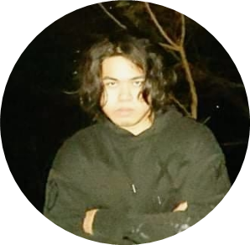
HOME
ABOUT US
NEXT SLIDE
Vladimir Perez
PROJECT MANAGEMENT PLAN s
SURVEIRAMS TICKETING SYSTEM
June 6, 2023

Slide 4
HOME
ABOUT US
NEXT SLIDE
Vladimir Perez
INTRODUCTION
Asia Pacific College (APC) has been using a manual process for recording incident reports and other activities using a logbook. This proved to be time-consuming as well as tedious due to its repetitiveness. SurveiRams is a mobile application that would address these concerns. It will automate the manual documentation process, as well as provide insights based on the data collected.

Slide 5
HOME
ABOUT US
NEXT SLIDE
Vladimir Perez
PROBLEM STATEMENT
The process of handwritten reports can be tedious and time-consuming, leading to inefficiency and errors in the documentation process. This can result in a lack of clarity and accessibility to important information for stakeholders such as managers and other employees who require accurate data in a timely manner. The current system also has unnecessary steps that could be eliminated when digitized such as rewriting the information from the logbook onto an incident report to be submitted to the Information Technology Resource Office (ITRO) or Building Maintenance Office (BMO).

Slide 6
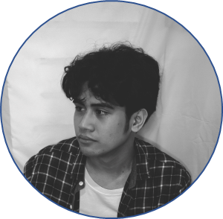
HOME
ABOUT US
NEXT SLIDE
Ian Onrubia
PROBLEM PURPOSE

Slide 7
HOME
ABOUT US
NEXT SLIDE
Ian Onrubia
PROJECT DELIVERABLES AND MILESTONES
The following deliverables must be met upon the successful completion of the SurveiRams project. Any changes to these deliverables must be approved by the project sponsor.
- Complete implementation of SurveiRams Ticketing System
- SurveiRams project’s technical documentation
o Project Charter (Long)
o Stakeholder Management Strategy
o Scope Management Plan
o Cost Management Plan
o Schedule Management Plan
o Work Breakdown Structure (WBS)
o Communications Management Plan
o Quality Management Plan
o Risk Management Plan
o Change Management Plan
o Procurement Management Plan
o Human Resource Plan
o Implementation Plan
- Recommendation list for future security considerations and enhancements

Slide 8
HOME
ABOUT US
NEXT SLIDE
Ian Onrubia
PROJECT DELIVERABLES AND MILESTONES
PROJECT MILESTONES | START DATES
Initiation | 04/11/2023 – 05/12/2023
Develop a Project Plan | 05/15/2023 – 09/12/2023
Analysis | 09/13/2023 – 10/10/2023
Design | 10/11/2023 – 04/01/2024
Testing | 04/02/2024 – 04/25/2024
Implementation | 04/18/2024 – 06/26/2024
Close Project | 07/27/2024 – 08/12/2024

Slide 9
HOME
ABOUT US
NEXT SLIDE
Ian Onrubia
STAKEHOLDER REGISTER
STAKEHOLDER | ROLE | IMPACT | INFLUENCE | WHAT IS IMPORTANT TO THE STAKEHOLDER? | HOW COULD THE STAKEHOLDER CONTRIBUTE TO THE PROJECT? | STRATEGY ON ENGAGING THE STAKEHOLDER
Jojo Castillo | ITRO Head | High | High | Directly receive reports | Project Approval and use of the application | Set a meeting
Jose Manuel Garcia | Campus Architect | High | High | Directly Receive reports, upload their physical files to the system | Project Approval and use of the application | Set a meeting
Marr Bringas | BMO Head | High | High | Directly send reports | Use of the Application | Interview
Mervin Quilang | Head Guard | High | High | Directly send reports | Use of the application | Interview

Slide 10
HOME
ABOUT US
NEXT SLIDE
Ian Onrubia
STAKEHOLDER REGISTER
STAKEHOLDER | ROLE | IMPACT | INFLUENCE | WHAT IS IMPORTANT TO THE STAKEHOLDER? | HOW COULD THE STAKEHOLDER CONTRIBUTE TO THE PROJECT? | STRATEGY ON ENGAGING THE STAKEHOLDER
Ian Christopher Onrubia | Project Manager | High | High | Project Team and System | Manage the project team | Set a meeting
Alexis Martin | Front-end Developer | High | High | Front-end System | Develop Front-end System | Set a meeting
Jan Karlo Boongaling | Documentation Specialist | High | High | Deliverables | Document the whole process of the system | Set a meeting
Yuan Serafico | Software Tester | High | High | Completed System | Test the software | Set a meeting
Vladimir Perez | Back-end Developer | High | High | Back-end System | Develop Back-end of the system | Set a meeting

Slide 11
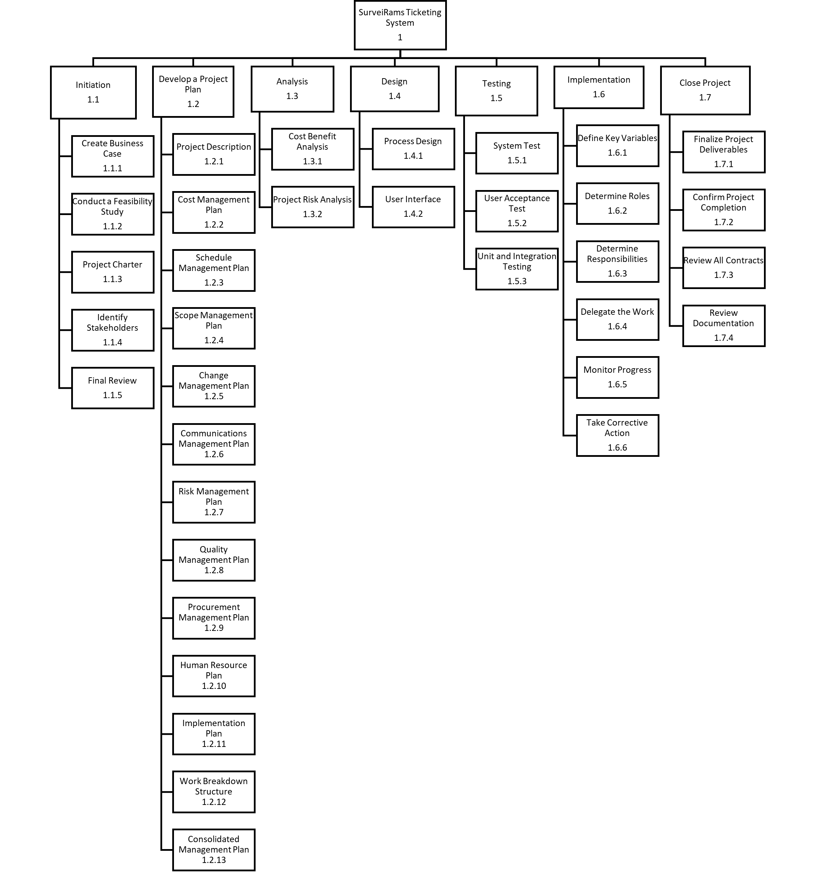
HOME
ABOUT US
NEXT SLIDE
Ian Onrubia
WORK BREAKDOWN STRUCTURE

Slide 12
HOME
ABOUT US
NEXT SLIDE
Ian Onrubia
WORK BREAKDOWN STRUCTURE

Slide 13
HOME
ABOUT US
NEXT SLIDE
Ian Onrubia
COST SCHEDULE SUMMARY

Slide 14
HOME
ABOUT US
NEXT SLIDE
Ian Onrubia
SCHEDULE GANTT CHART SUMMARY

Slide 15
HOME
ABOUT US
NEXT SLIDE
Ian Onrubia
CHANGE CONTROL BOARD
Change Control Board Role | Role | Name | Contact | Responsibilities
Change Control Board Chair | Project Sponsor | Mr. Jose Manuel Garcia | manoletg@apc.edu.ph | has the authority to grant or decline significant changes. responsible for assessing low-impact changes and have the power to overturn the Project Manager's decisions regarding change requests.
Change Control Board Chair | Project Sponsor | Mr. Jojo F. Castillo | jojoc@apc.edu.ph | has the authority to grant or decline significant changes. responsible for assessing low-impact changes and have the power to overturn the Project Manager's decisions regarding change requests.

Slide 16
HOME
ABOUT US
NEXT SLIDE
Ian Onrubia
CHANGE CONTROL BOARD
Change Control Board Role | Role | Name | Contact | Responsibilities
Change Control Board Member | Project Manager | Ian Onrubia | iconrubia@student.apc.edu.ph | Assess the impact of the change request as high or low. Approve or reject low-impact changes. Develop an action plan for implementing approved change requests. Communicate the necessary steps for implementing the changes. Update the project plan, budget, and schedule as required.
Change Control Board Member | Change Coordinator | Jan Karlo Boongaling | jmboongaling@student.apc.edu.ph | Oversee the implementation of the Change Management process. Update the change logs as necessary. Prepare the Change Status Report. Generate a monthly report summarizing the status of the change control logs.

Slide 17
HOME
ABOUT US
NEXT SLIDE
Ian Onrubia
COMMUNICATION MATRIX
Communication | Purpose | Medium | Frequency | Audience
Project Planning | In order to establish a solid base and maintain the team's focus and progress | OpenProject, Meeting | Once Before the start of the project | Project Manager Project Team Project Sponsor
Release planning | To manage dependencies | OpenProject, Meeting | Once every month | Project Manager Project Team Project Sponsor
Monthly Sprint Planning | To determine monthly goal | OpenProject, Meeting | Once before starting another feature | Project Manager Project Team Project Sponsor
Management processes | To ensure there is coordination in the team | Email, OpenProject | Once every week | Project Manager Project Team Project Sponsor

Slide 18
HOME
ABOUT US
NEXT SLIDE
Ian Onrubia
COMMUNICATION MATRIX
Communication | Purpose | Medium | Frequency | Audience
Product backlog | Inform stakeholders the tasks that has not been processed and need to be addressed | Email/ Meeting | When necessary | Project Manager Project Sponsor
Project Consultation | Enhance project by having stakeholder’s guidance and comments | Meeting | Once every week | Project Manager Project Team Project Sponsor
Project Update | Weekly update on the progress of the project | Email | Once every week | Project Manager Project Team Project Sponsor

Slide 19
HOME
ABOUT US
NEXT SLIDE
Ian Onrubia
RISK REGISTER
Risk ID | Risk Category | Risk Description | Risk Assessment | Owner | Mitigating/Avoiding Action
01 | Technical | Data loss | High | Developers | Create backups for the data such as exporting the database contents into a document
02 | Technical | System Bugs | Medium | Developers | Revisit and debug source code
03 | Technical | Power Failure | Medium | Project Manager | Activate backup electricity generators
04 | Technical | Unstable Internet Connection | Medium | Project Manager | Buy load to use mobile data
05 | Cost | The project goes over budget | Low | Project Manager | Request for additional budget from Project Sponsors

Slide 20
HOME
ABOUT US
NEXT SLIDE
Ian Onrubia
IMPLEMENTATION

Slide 21
HOME
ABOUT US
NEXT SLIDE
Ian Onrubia
QUESTIONS?

Slide 22
HOME
ABOUT US
NEXT SLIDE
Pares Point
KAYVI byte.​
The team thanks you for listening!

Slide 23
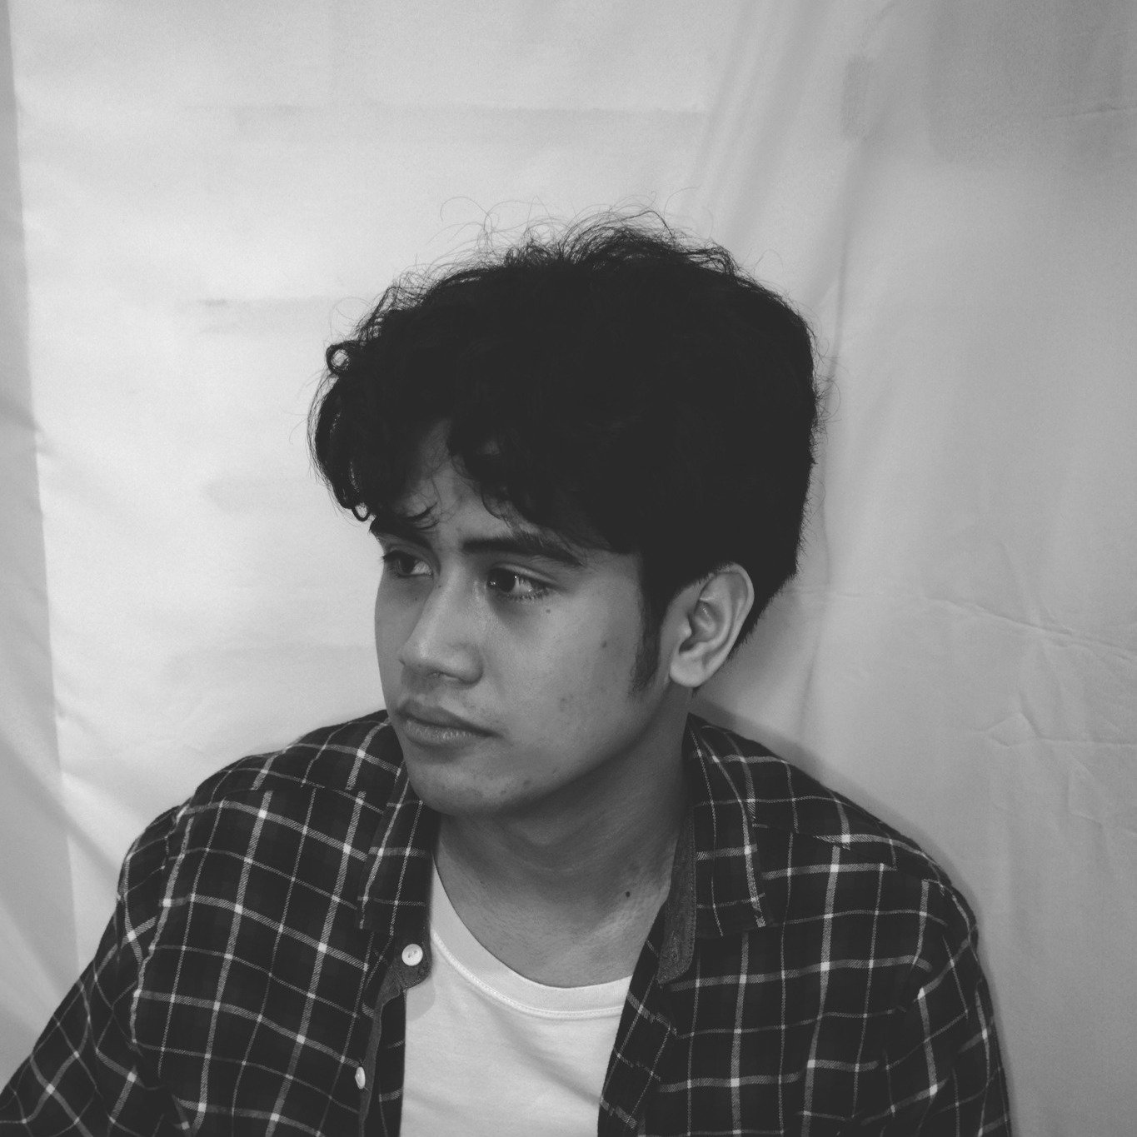
HOME
ABOUT US
END
MEMBER CONTRIBUTIONS
K
A
Y
V
I
Jan Karlo
Boongaling
Alexis Martin
Yuan Alexandrei Serafico
Vladimir Ken
Perez
Ian Christopher Onrubia
Documentation
Team Leader
Documentation
Documentation
Product Developer
Business Case
Stakeholder Management Strategy
Scope Management Plan
Cost Management Plan
Schedule Management Plan
WBS
Communications Management Plan
Quality Management Plan
Procurement Management Plan
Implementation Plan
Business Case
Project Charter
Stakeholder Management Strategy
Scope Management Plan
Cost Management Plan
Schedule Management Plan
WBS
Communications Management Plan
Risk Management Plan
Business Case
Stakeholder Management Strategy
Scope Management Plan
Cost Management Plan
Schedule Management Plan
WBS
Communications Management Plan
Quality Management Plan
Procurement Plan
Change Management Plan
Human Resource Plan

